Slide 1


Application of RL in Pacman
Ng Zhi Da A0034082R
Yap Dian Hao A0184679H

Slide 2

Objectives
Formulate the classic Pacman game into a Reinforcement Learning (RL) problem
Build a Pacman model using python, making use of existing open-source libraries
Apply the RL techniques, specifically Deep Q-Learning (DQN) to model the game
Examine how the changing the hyperparameters will affect the outcome and performance
Recommend the best approach, algorithm and hyperparameters

Slide 3
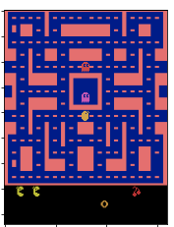
Pacman Game
Dot
Energizer
Ghosts
Pacman is an action maze chase video game
Single agent – Pacman
Main objective is to eat all of the dots placed in the maze while avoiding four colored ghosts
3 lives are given for each episode / game
4 energizers in the 4 corners, eating these allow Pac-Man to eat ghosts for bonus points; After which ghosts will return to the center box to "regenerate“
Rewards are given for eating the dots, eating the ghost (after powered by energizers)
Tunnel
Pacman
Level 1
Screenshot of Pacman from OpenAI gym

Slide 4
Formulating Pacman into RL Problem
Environment
Leverage on OpenAI gym “MsPacman-v0”*
State
4 frames of processed image captured from the gym environment
Image captured position of Pacman and ghosts and the direction of travel
Action
9 possible actions ('NOOP', 'UP', 'RIGHT', 'LEFT', 'DOWN', 'UPRIGHT', 'UPLEFT', 'DOWNRIGHT', 'DOWNLEFT’ )
Reward
+10 per dot consumed
+50 per energizer consumed
+200 per ghost consumed
*https://gym.openai.com/envs/MsPacman-v0/

Slide 5
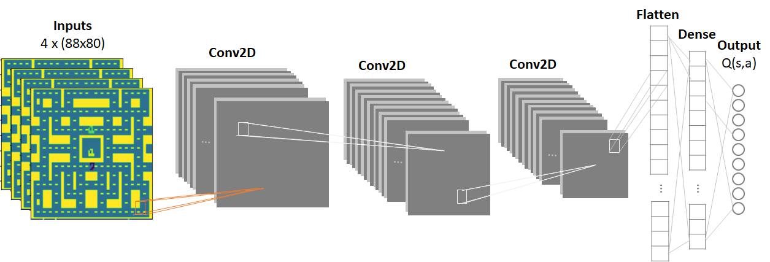
Approach
Develop a DQN with experience replay and fixed target, with epsilon greedy policy
Used Convolutional Neural Network (CNN) to take in the observed frames as inputs and output the predicted Q values
2 Neural Networks of the same architecture are trained (Main NN and Target NN)
Main NN - For prediction of Q value
Target NN - For learning and transferring of weights to Main NN after 100 steps

Slide 6
Tools and Resources used
OpenAI’s gym environment
Python 3
Tensorflow
Numpy
Keras
Matplotlib
Jupyter

Slide 7
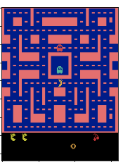
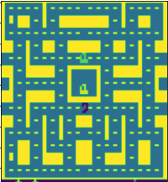
Pre-Processing
To convert from RGB (3 dimension) to single scale (1 dimension) to reduce the complexity
To crop the observed frame to the maze to filter away unnecessary information

Slide 8
Model training
We ran the training for 1500 episodes.
In each episode, the agent chooses a series of actions based on the epsilon greedy policy.
Exploration: Random action (rand number <= epsilon)
Exploitation: Based on action that yield highest predicted Q value (rand number > epsilon)
After executing the action, we store the state, action, observed reward, new state in the memory buffer.
For learning, we sample a small batch from the memory buffer, to fit the “Target” NN
Use the “Main”NN to predict the maximum Q value.
Apply Bellman approximation for the state-action values and to compute predicted Q value and compare with the NN predicted to compute the loss.
Minimize the loss with Stochastic Gradient Descent.
Every 100 steps, update the “Target” NN with the “Main” NN.

Slide 9
Parameters Selection
Huber Loss vs Mean Squared Error (MSE)
MSE seems to yield better results as comparing using Huber Loss
Learning Rate
Learning rate of 0.001 seems to yield better results
MSE
LR = 0.001
Huber
LR = 0.01

Slide 10
Parameters Selection
State representation
1 frame state seems to yield better results in early phase, where agent is more concerned about learning fundamental. As agent starts to learn more complex strategies like evading ghost, the direction of ghost may be more critical for agent to stay alive longer.
Discount Factor
Not significant different in results based on 700 episodes.
Discount factor of 0.99 selected (more commonly used in our open source research)
4 frames state
Discount factor = 0.99
1 frame state
Discount Factor = 0.9

Slide 11
Key Parameters
Hyperparameter | Value | Remarks
Replay Buffer | 20,000 steps | Double ended queue to store actions, rewards, done states, states
Training Batch Sample Size | 48
Epsilon Decay Rate | 1,000,000 steps | used for the Epsilon greedy approach in choosing exploration and exploitation
Epsilon Range (Max / Min) | Max = 1, Min = 0.05
Learning rate, 𝜶 | 0.001 | guarantees the utility function to converge
Discount factor, 𝛄 | 0.99 | guarantees finite reward horizon

Slide 12
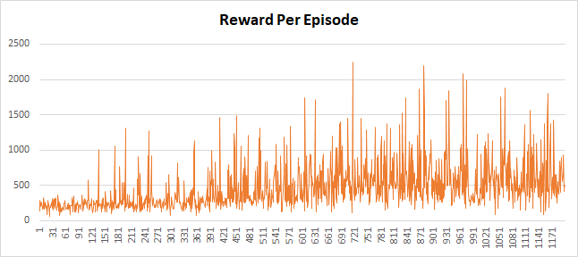
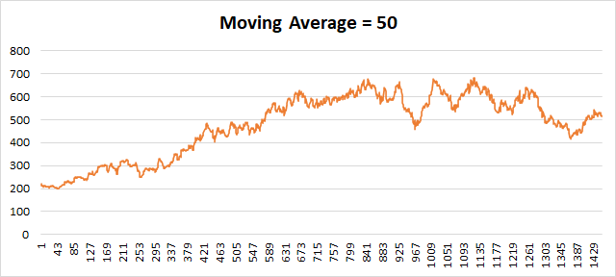
Outcome
Based on 1500 runs (~40hr CPU time)
Looking at the moving average, the average rewards increases from 200 (untrained) to about 700 (around 1000 runs) and stabilizes.

Slide 13
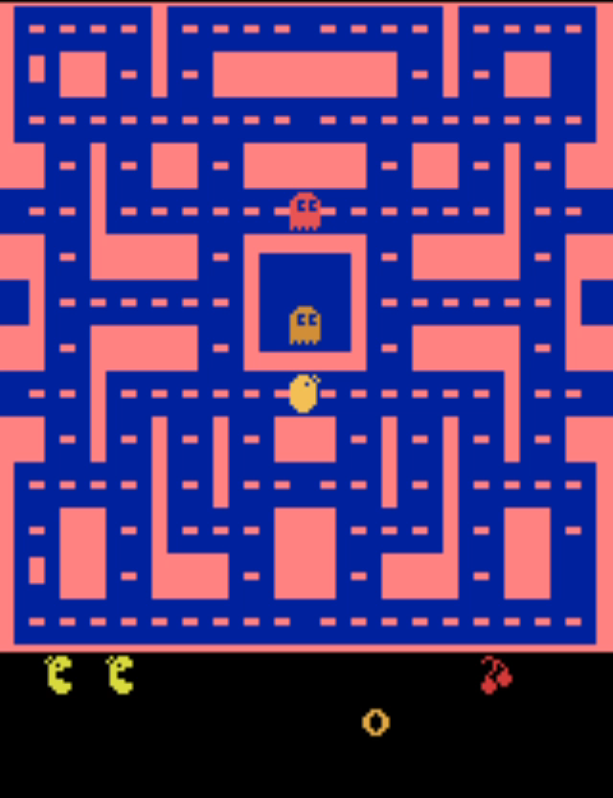
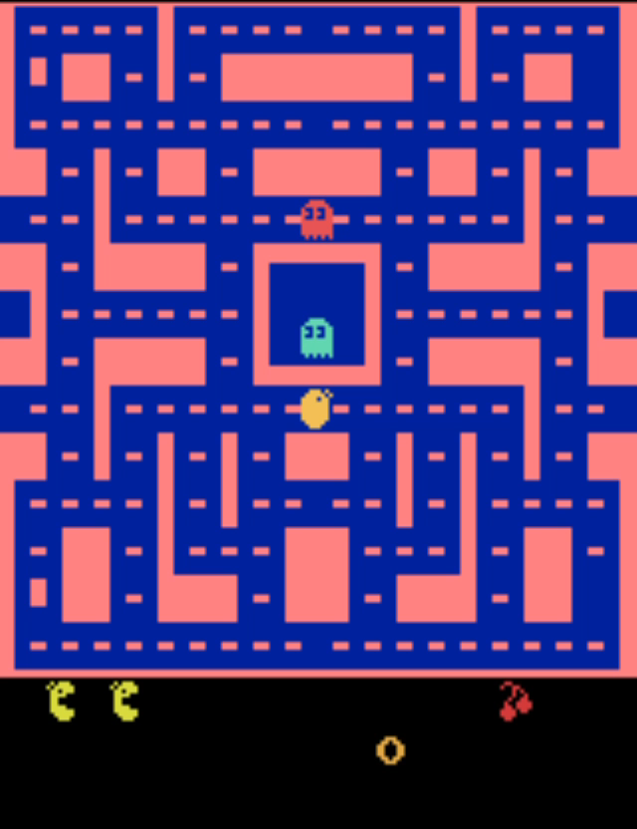
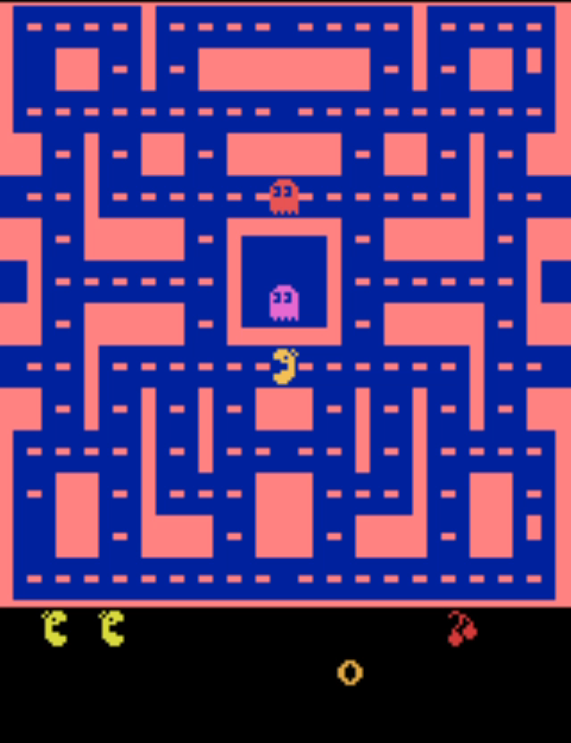
Outcome
Prior to Training
Exhibit random actions, on average stay near starting point, due to randomised behaviour, with minimal rewards
After 500 runs
Agent learnt to explore the maze to eat the dots to increase the rewards
After 1000 runs
Pacman learn a new strategy to eat the energizer to have gain bonus points, and ability to eat ghost to gain more points

Slide 14
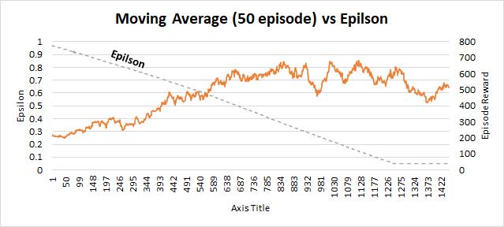
Analysis
As epsilon decreases especially towards >1200 runs, we see that learning plateau. We hypothesis that, as epsilon decreases, the DQN has reached a local minimum and due to insufficient exploration, the results did not improve further

Slide 15
Outcome
Trained agent is observed to have learnt strategies such as eating dots to increase rewards
More complex strategies such as going towards the energizer to increase bonus rewards are also observed
However, the agent still has limitation in evading ghost and navigating the maze
In some instances, the agent seems to be “stuck” in some minima, i.e. stop moving in some corners
The team hypothesis that more training can be done to improve the agent behaviour*
*Currently, the team is continuing to train the DQN, and any new findings will be updated in the final report

Slide 16
Challenges
Results are still not comparable to human
Parameters tuning
Trial and error involved, e.g. determining a suitable epsilon value (only after run, we can analyse the how went the agent react to the chosen epsilon figure)
Long training time
Also challenging for debugging. Abnormalities may not surface until later phase (e.g. agent not learning)
Lack of documentation of libraries such as OpenAI’s Pacman gym environment

Slide 17
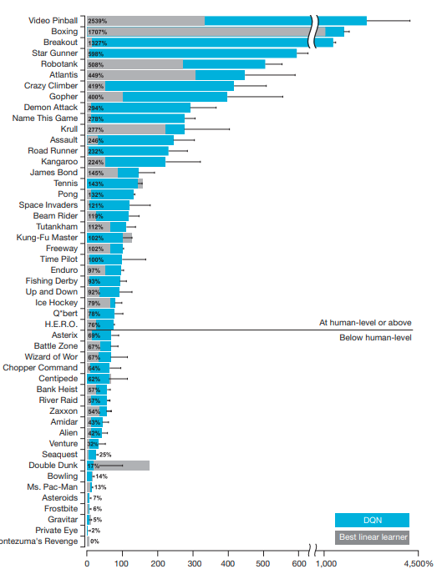
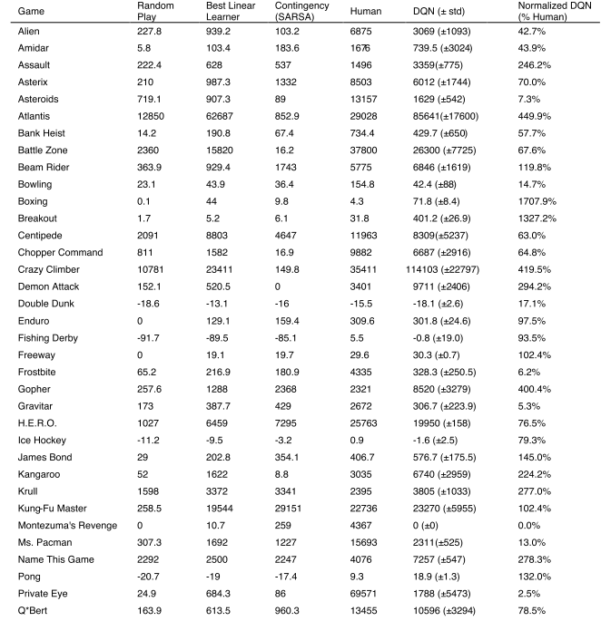
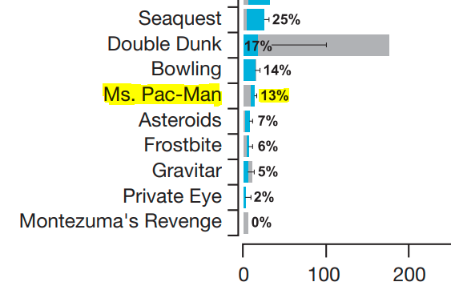
Comparison with Google Deepmind*
Deepmind trained for a total of 50 million frames (that is, around 38 days of game experience in total) and used a replay memory of 1 million most recent frames.
Pacman - 13% of Human Level
Proj team achieved 700 with 1.5 mil frames and 1.8 days training
*https://storage.googleapis.com/deepmind-media/dqn/DQNNaturePaper.pdf

Slide 18
Summary
Formulated Pacman into a RL problem
Build and implemented Pacman DQN model using python
Successfully train Pacman agent to execute behaviour to improve rewards in the Pacman game
Learnt about implementation of DQN for RL and pitfalls through hands on practice.

Slide 19

Questions

